Slide 1
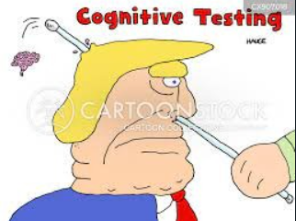




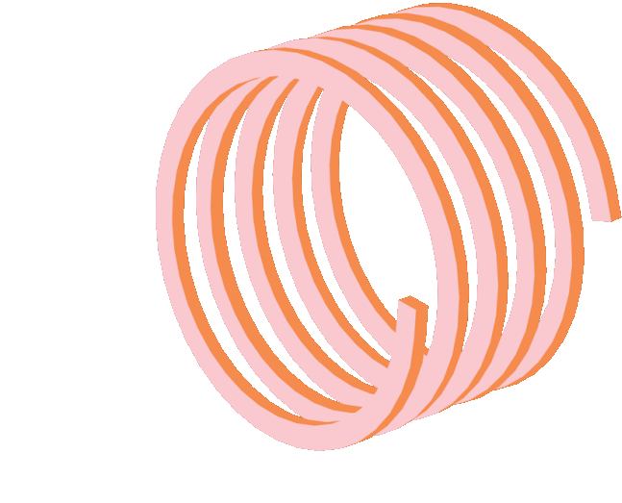
Detection of Cognitive Impairment based on eye tracking data using Deep Learning Technique's

Slide 2


Team Members
U.Nishitha – BL.EN.U4CSE20187
Revanth Kandimalla – BL.EN.U4CSE20067
M.Mourya Vardhan Reddy – BL.EN.U4CSE20103

Slide 3


Data Collection

Slide 4



The data which is been collected is in the form of an Excel sheet using an eye tracker, with various features like Time, Left Pupil Diameter (mm), Left Pupil Pos X, Left Pupil Pos Y, Right Calibrated, Right Pupil Diameter (mm), Right Pupil Pos X, Right Pupil Pos Y, Image Width, Image Height, Right Gaze Point X (% Display Width), Image Height, Image Scale Factor, we now have 4 datasets naming TMT_A1, TMT_B1, TMT_A2, TMT_B2, each indicate different images to check the cognitive impairment of a human.

Slide 5
Data Preprocessing

Slide 6
The eye tracker only gives the data in x and y coordinates and from these coordinates the fixations, saccade, latency error rate, etc., are found.
A subset of data pre-processing which happens in Pre – Processing stage, refers to any transformation done on original data to prepare it for the next data analysis process.
Data cleaning is a process of data pre-processing where irrelevant and inconsistent data is identified and removed.

Slide 7
Feature Extraction

Slide 8


The data collected from eye tracker has x and y coordinates only. So we need to extract features from these
Saccade detection
Fixation Detection
Blink detection
MMSE Score (Mini-Mental State Examination)

Slide 9


MM
Modelling The Data

Slide 10
MLP Network Architecture:
Multi-Layer Perceptron Network has fully dense layers which allow transforming input dimensions to any desired dimensions.
MLP can deal with both linear and non-linear separable data.
The data which is given as input will be passed to many hidden layers present to get the desired output.

Slide 11


CNN Network Architecture
CNN is a special type of neural network.
Main idea behind CNN is using filters which are sliding windows by which we can find patterns and similarities and features image has edges and shapes and filters are responsible to detect these features of the image first layer in CNN gives edges and this is passed to further layer and next layer gives some features.

Slide 12
Accuracies

Slide 13
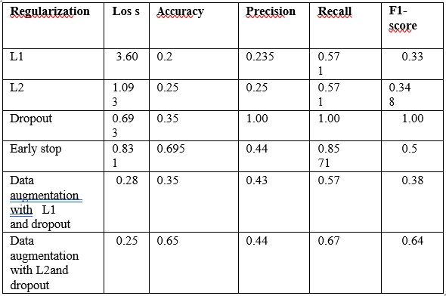

Accuracies after Regularization

Slide 14
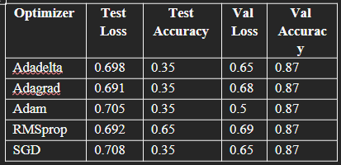
Accuracies after Optimization

Slide 15
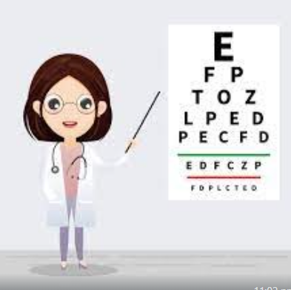
Graphs

Slide 16
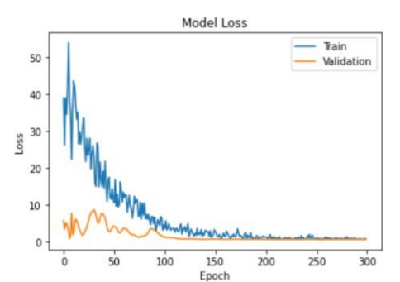
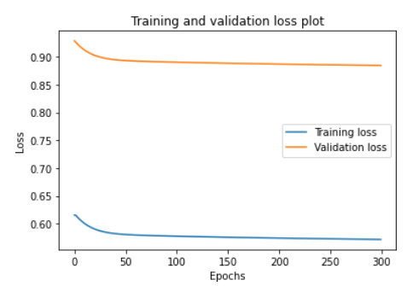
Training and Validation loss graph for MLP Network.
Training and Validation loss graph for CNN Network.

Slide 17
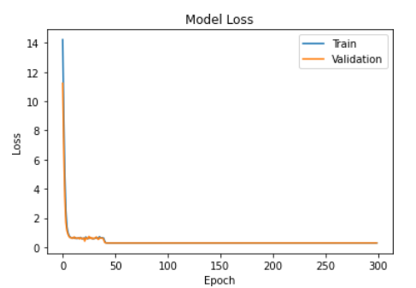
Training and Validation loss graph after regularization.

Slide 18


User Interface

Slide 19
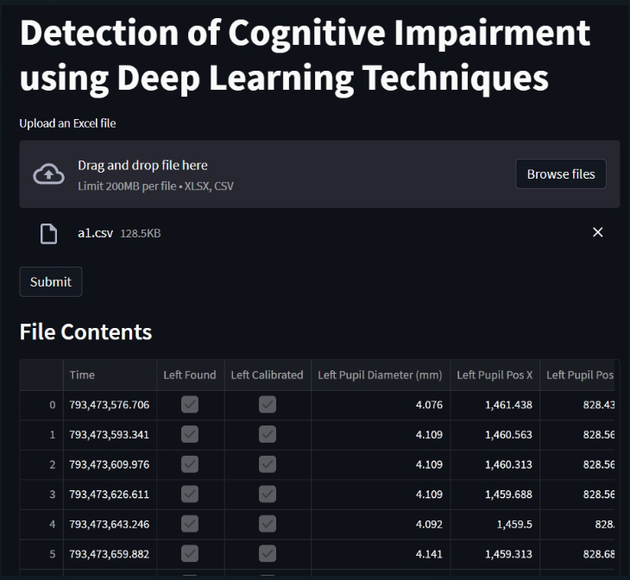

Slide 20
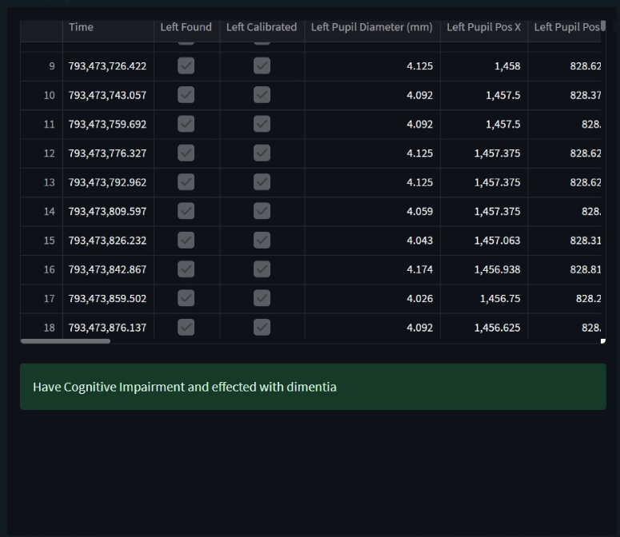

Slide 21
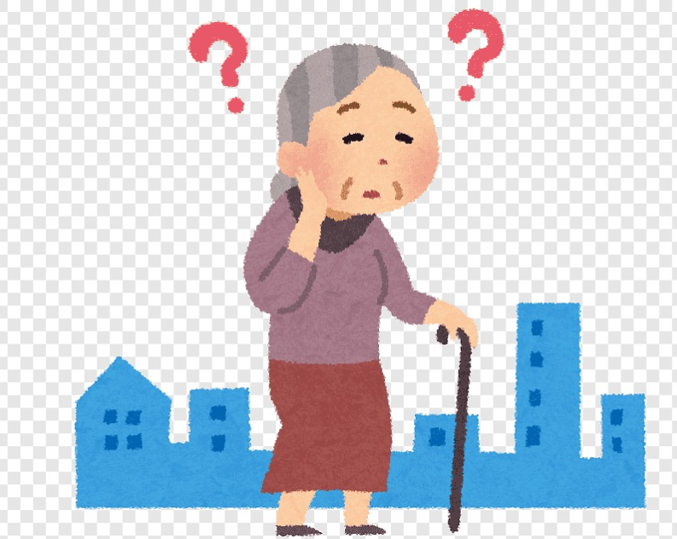
Conclusion
Deep learning models worked quite well and they were able to handle, pre-process the data, and classify the patients as high and low classes. The patients who were classified as high needed to refer the doctors as soon as possible. By using the Naïve-Bayes classifier for the classification of data, Early stop for regularization, and ADAM as an optimizer we obtained an accuracy of 85% after testing it with the dataset.

Slide 22


